Slide 1
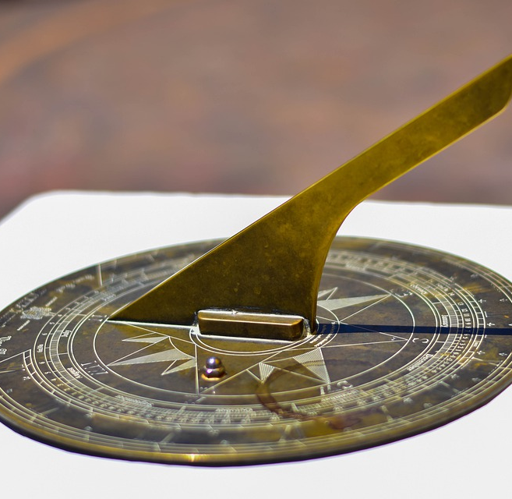
Project Sundial
A 3D Interface for Energy Meter Data
Built on Circaevum

Slide 2
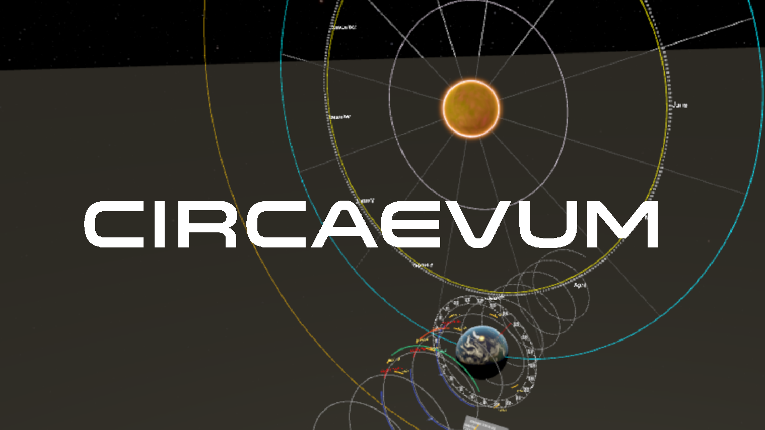
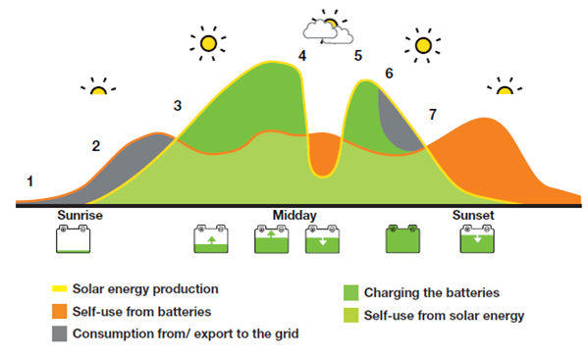
Outline
1. Background 2. Daily Energy Data 3.

